Slide 1
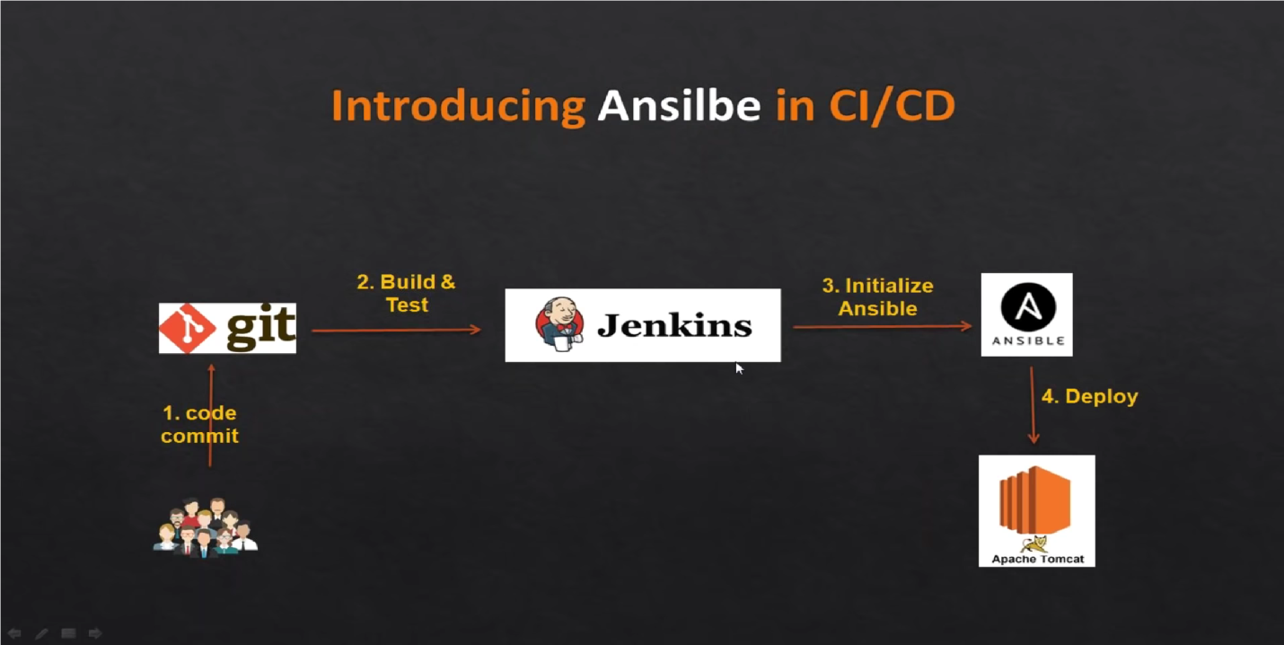
CICD Project – 2 Github – Maven – Jenkins –Ansible -Tomcat Ubuntu Server

Slide 2
Background
Build a simple CICD project that uses Jenkins and plugins to deploy code from Git and use Ansible deploy to Apache Tomcat EC2 server.
Objectives
Start up Ansible Server
Manage all plugins into Jenkins (Java –JDK, Maven – Invoker & Plugin; Install git; Ansible, Tomcat)
Edit a bunch of files via CLI in Jenkins, Ansible and Tomcat servers – Add users on Tomcat so that you can use from GUI
Launch WinSCP to copy files from windows local directory to EC2 instance. WInSCP can be assessed using putty. Ensure that you have your key pair file in the WinSCP directory. Also use putty to convert the .pem to .ppk file
Configure war files, yml file and container with their usernames and passwords in Jenkins
Deploy the automated pipeline from Ansible Master into Tomcat EC2 instance (Slave)

Slide 3
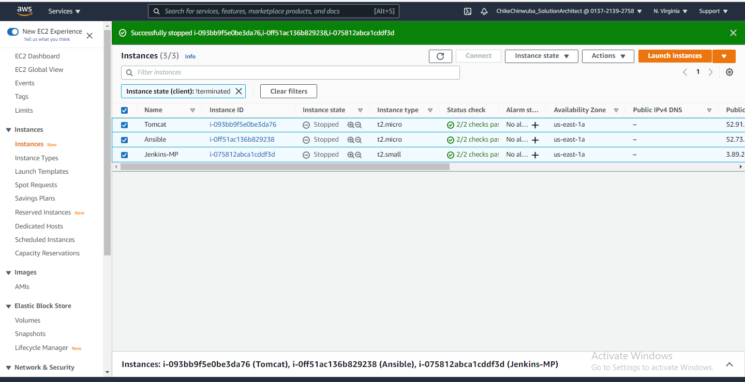
Jenkins (Bitnami Market place T2 small) Tomcat (Ubuntu 18:04) & Ansible EC2 Instances

Slide 4
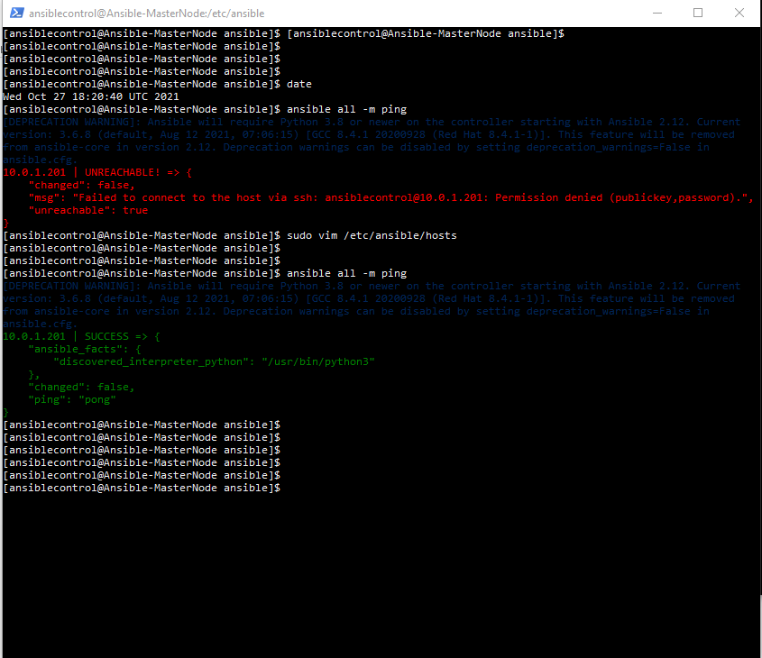
Ansible all – m ping to Slave node – Tomcat server – Successful

Slide 5
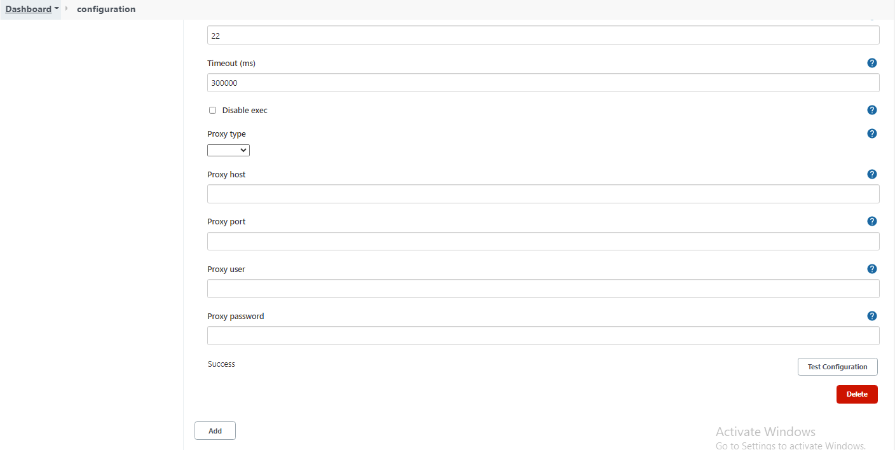
Test Connection between Jenkins and Ansible – Successful

Slide 6
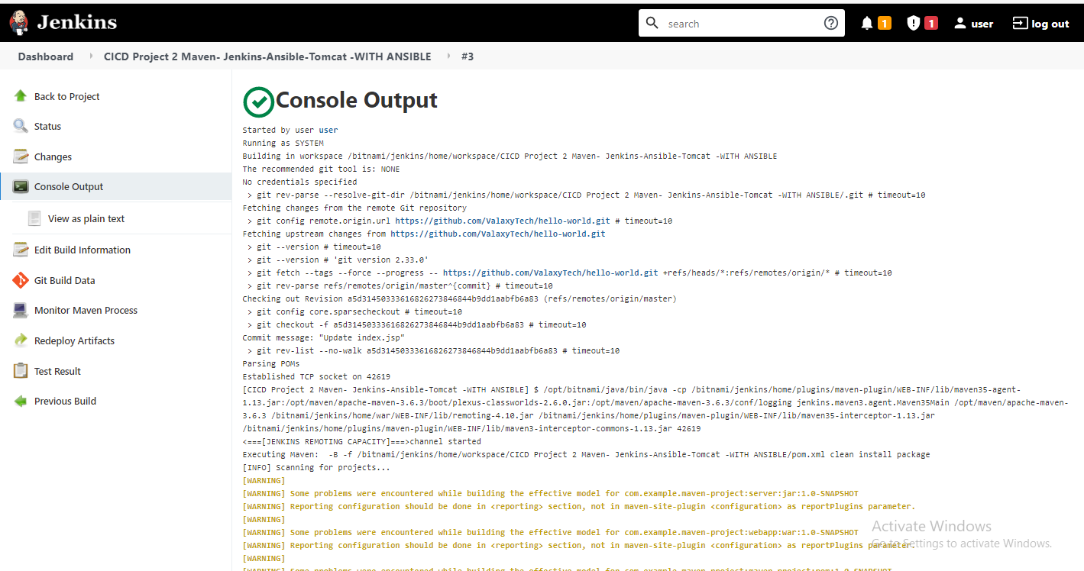
PROJECT 2 Maven-Jenkins-Ansible-Tomcat– Successful

Slide 7
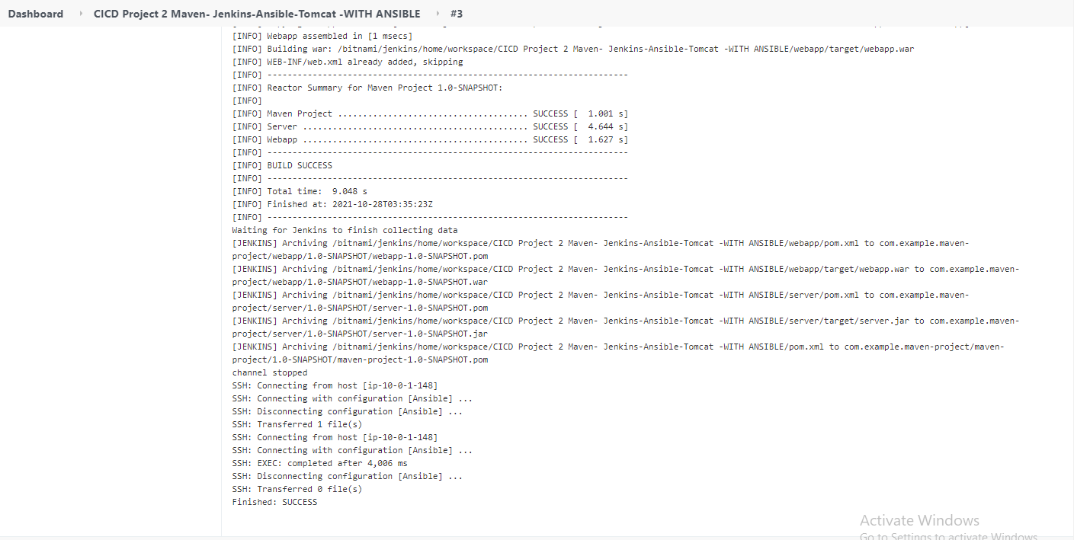
PROJECT 2 Maven-Jenkins-Ansible-Tomcat– Successful

Slide 8
CICD Application Components
Git
Go to Git public repository and use git clone url - https://github.com/ValaxyTech/hello-world.git
Jenkins
Could not install Jenkins from Redhat server for compatible reasons. I had to go to Amazon Marketplace and use
Bitnami Jenkins with T2 small instance.
Launched Jenkins and got the instance credentials from the system log under monitoring and trouble shooting
Maven (Only for Java scripts in Github)
Incorporate Maven package into Jenkins Bitnami server and check the version.
Go to Jenkins GUI and go to source action and install without restart the following plugings - Maven Invoker and unleash Maven pluging
Ansible
Launched an EC2 instance and configure and install the instance as the Ansible Master node.
Configure the Tomcat Ubuntu Server as the Slave node and ensure that you can both master and slave nodes can ping each other
Tomcat Server
Launched an Ubuntu 18.4 instance in Amazon. Configure and install tomcat package into the instance.
Configure the Tomcat server as the Slave node to the Ansiblecontrol Master node.
Ensure connectivity between Ansible and Tomcat

Slide 9
CICD – Integration and Deployment
Jenkins
Use Jenkins GUI – Log in with username and password gotten from instance system log
Ensure to install the following plugins :-
Maven Invoker
Unleash Maven Pluging
Github pluging (Already installed)
Configure the project by adding the public git clone url
Configure the project by adding JDK – Java and the Java home directory
Go to build and add Root POM as ‘pom.xml’ . Goals and options as ‘clean install package’
Add post-build steps*
Send files or execute commands over SSH
SSH Server : `ansible_server`
Source files: `webapp/target/*.war`
Remote directory: `//opt//playbooks
Add post-build steps*
Send files or execute commands over ssH
SSH Server : `ansible_server`
Exec command ansible-playbook /opt/playbooks/copywarfile.yml
Launch WinSCP to copy *.yml into the ansiblecontrol Masternode instance so that it can execute the playbooks. WinSCP will
retain the .yml format when you copy it across from windows local directory platform to the Ansible Master node.
Build in Jenkins and watch the console output for the logs. If there is any failure, check the trail of logs and begin trouble shooting until you have a successful build to deployment on the Tomcat Server.

Slide 10
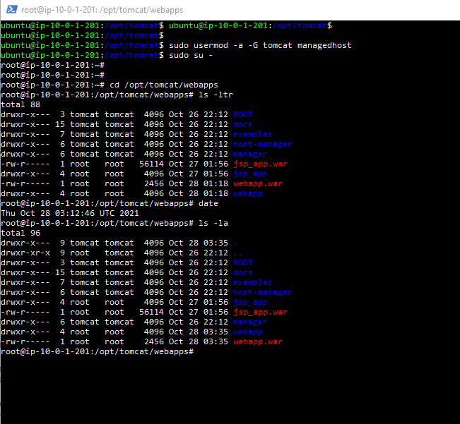
PROJECT 2 New War file deployed – Successful

Slide 11
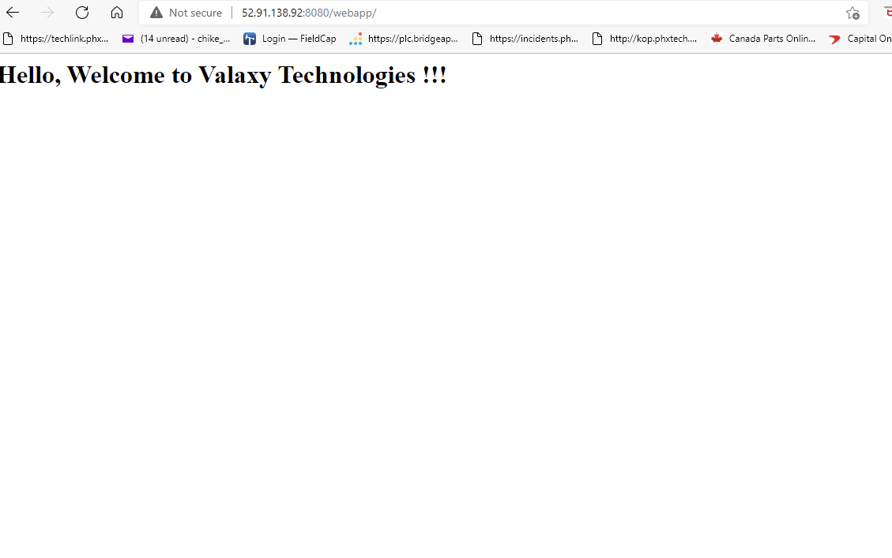
PROJECT 2 http://<IP>/webapp

